Slide 1

FRA 1-0 BEL Post-Match Report Presentation
RBFA Technical Interview
Filippo Molino

Slide 2
Design Stage
What data do I have?
The focus is on tracking data, but I also have access to event data from the match
Who is the target?
Members of the national team staff, so football experts with some knowledge about related data
What is the intended result?
An impactful, visualization-focused report that contains information about specific aspects of the game
Sections have to be well organized and easy to read and interpret
Not closed answers, but tool to help decision making and interpretation
Notes:
The goal of analysis is not to provide a direct answer, but to guide the decision making

Slide 3
Some References
Ben Griffis post-match dashboard: https://bengriffis.com/
David Sumpter, “Introduction to Tracking Data”: https://www.youtube.com/live/fYqEnoOV9Po
John McKay, “How to Make Graphs Like The Athletic in Python”: https://youtu.be/v3uI44ZA_WU?si=iRu0-hqPyFPfl8Sw

Slide 4
Data Pre-Processing
Checked for missing values
Centered x,y coordinates to match the UEFA standard (105x68m), with the bottom-left corner at (0,0)
Adjusted tracking data by inverting the direction of attack to align with event data
Added a player number feature to enhance visualization clarity
Split the location column into separate latitude and longitude columns for event data

Slide 5
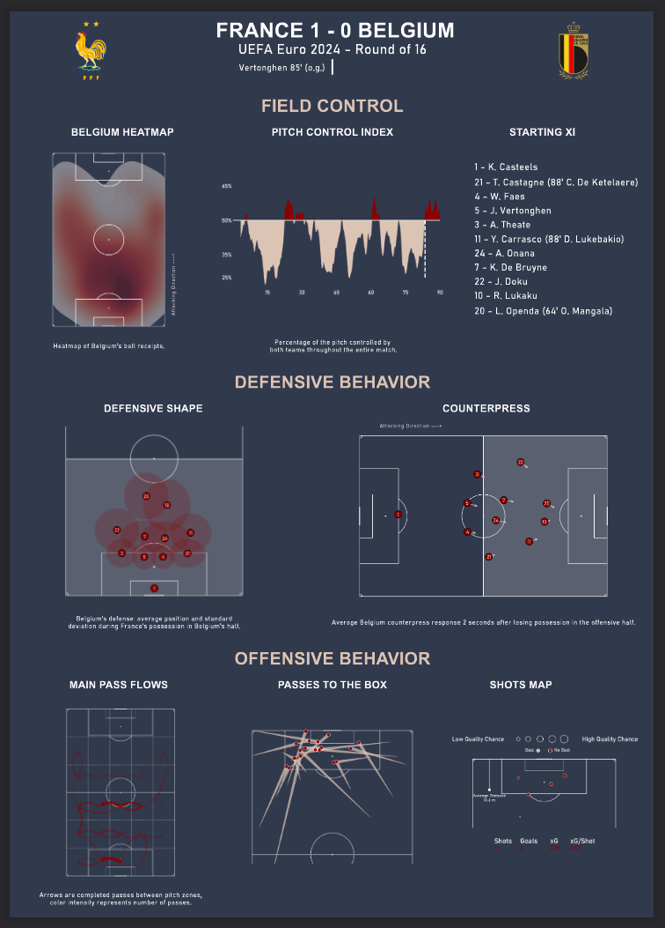
Report Sections
FIELD CONTROL: which team had the control of the field and when?
DEFENSIVE BEHAVIOR: how did Belgium behave without possession of the ball?
OFFENSIVE BEHAVIOR: what did Belgium’s goal-scoring opportunities look like?
Notes:
focus on 3 crucial aspects of a match

Slide 6
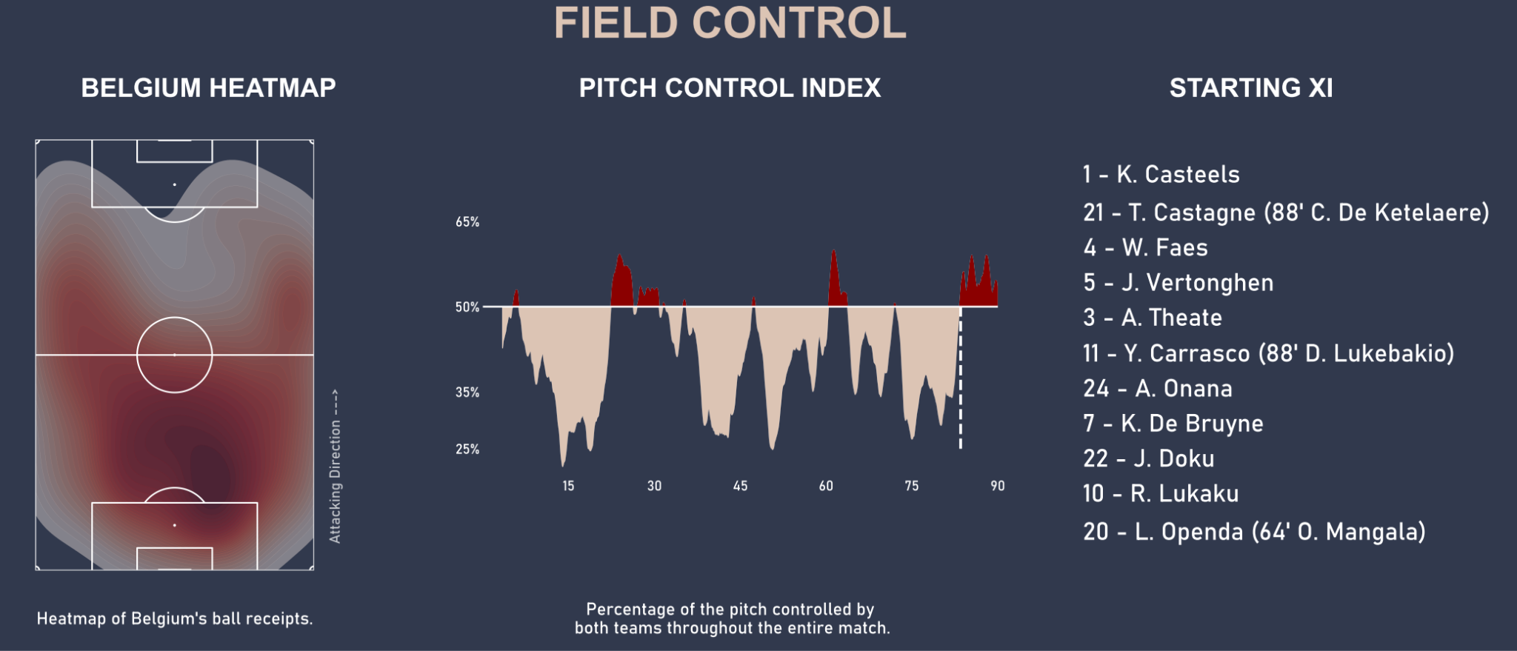
FIELD CONTROL SECTION

Slide 7
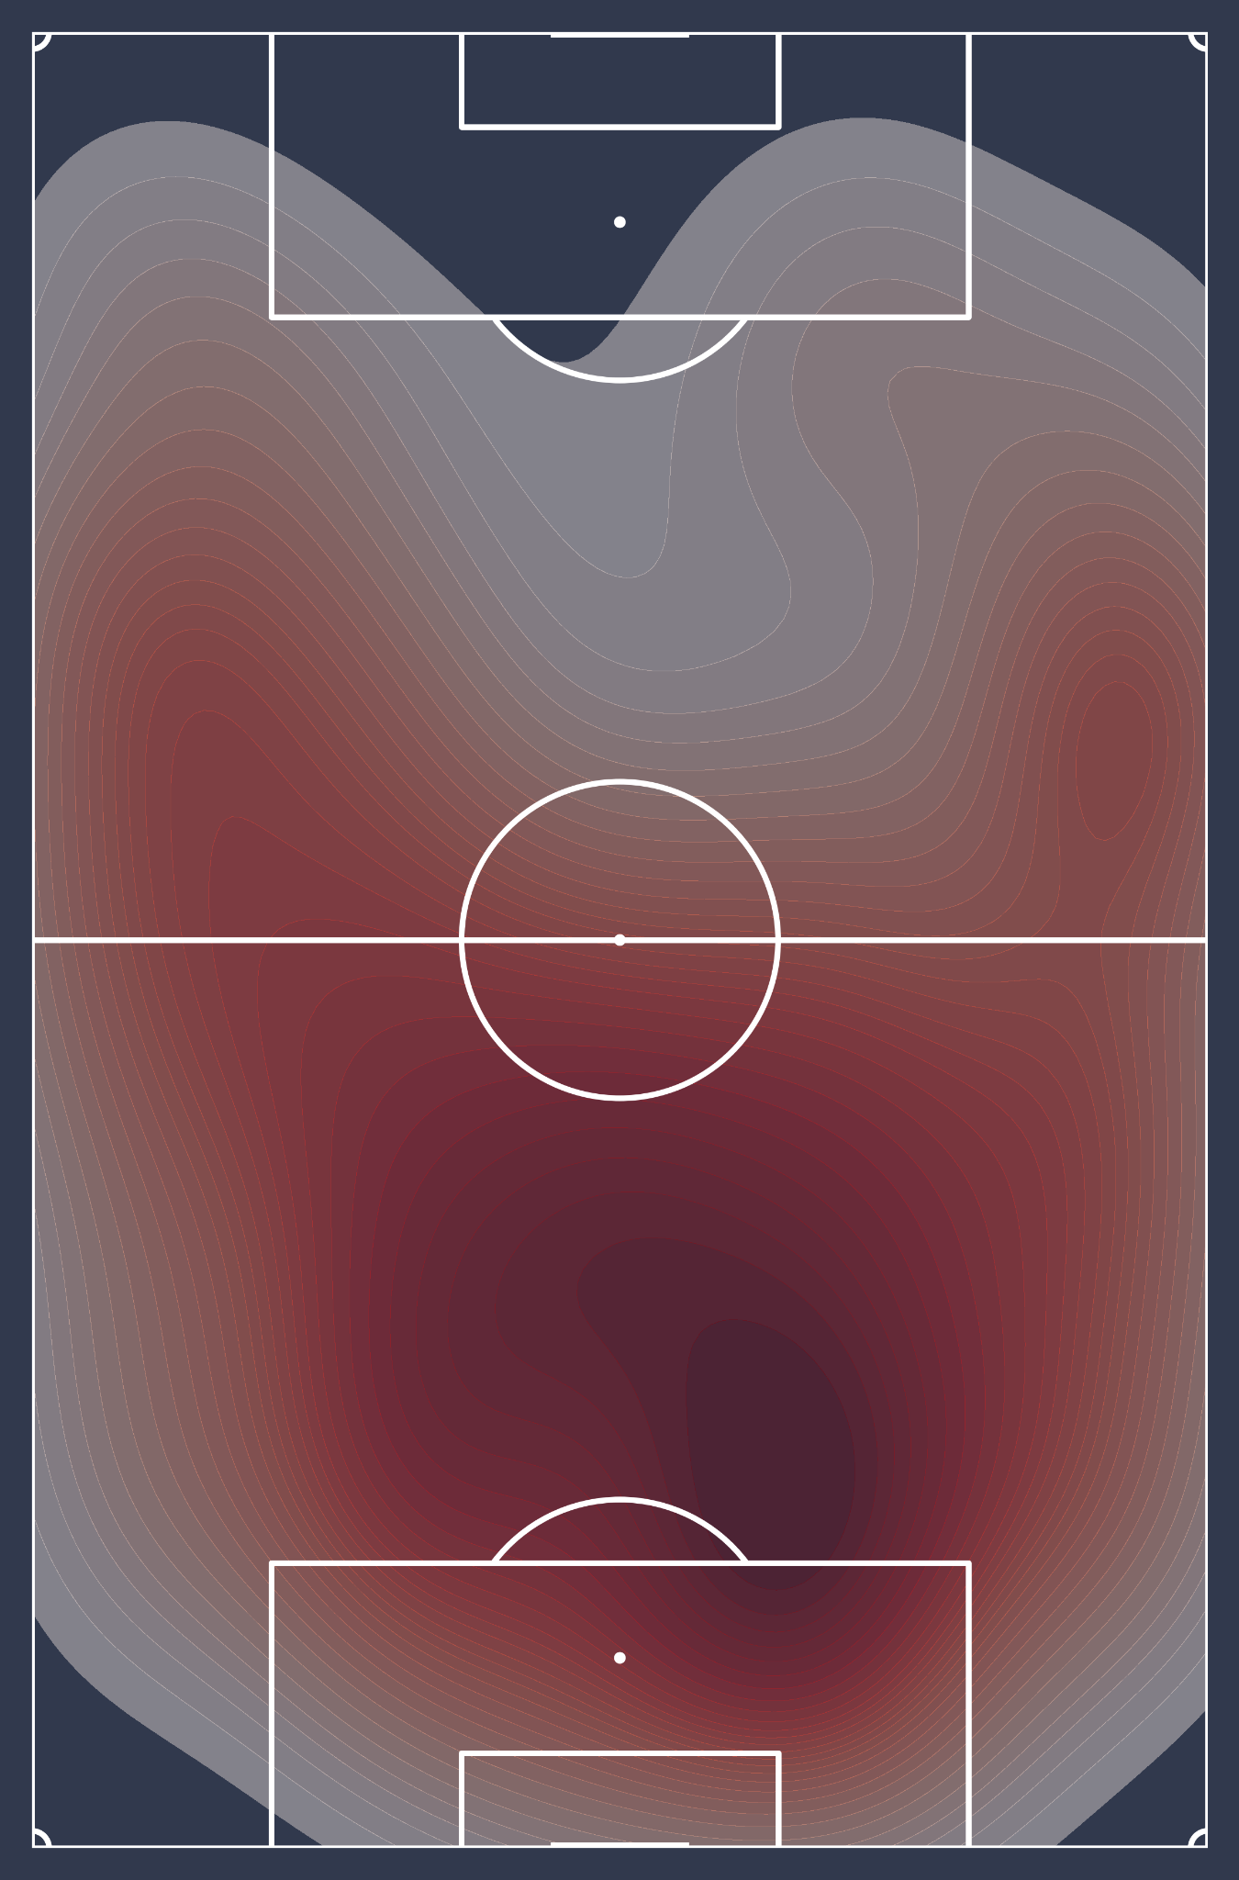
Field Control - Heatmap
Heatmap: represents the Belgium players’ ball receipts throughout the match
Based on event data
Easy to interpret

Slide 8
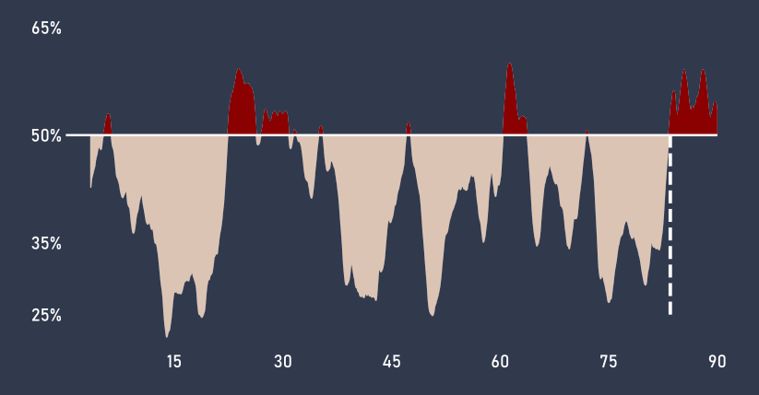
Field Control - Pitch Control Index
Based on tracking data: utilizes real-time positional data
Nearest-Neighbor approach with Voronoi diagrams: tracks match momentum by analyzing space control over time.

Slide 9
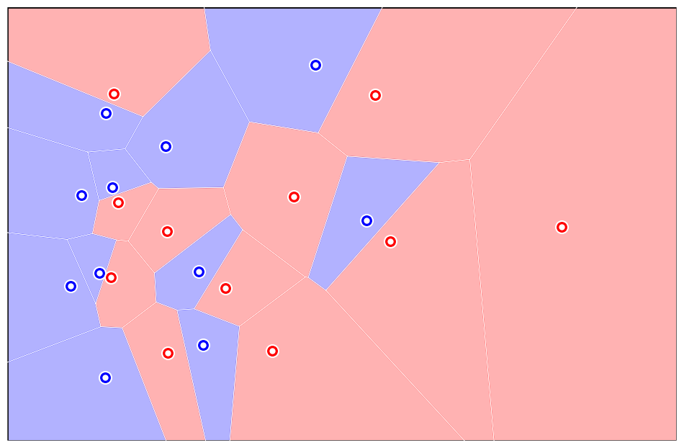
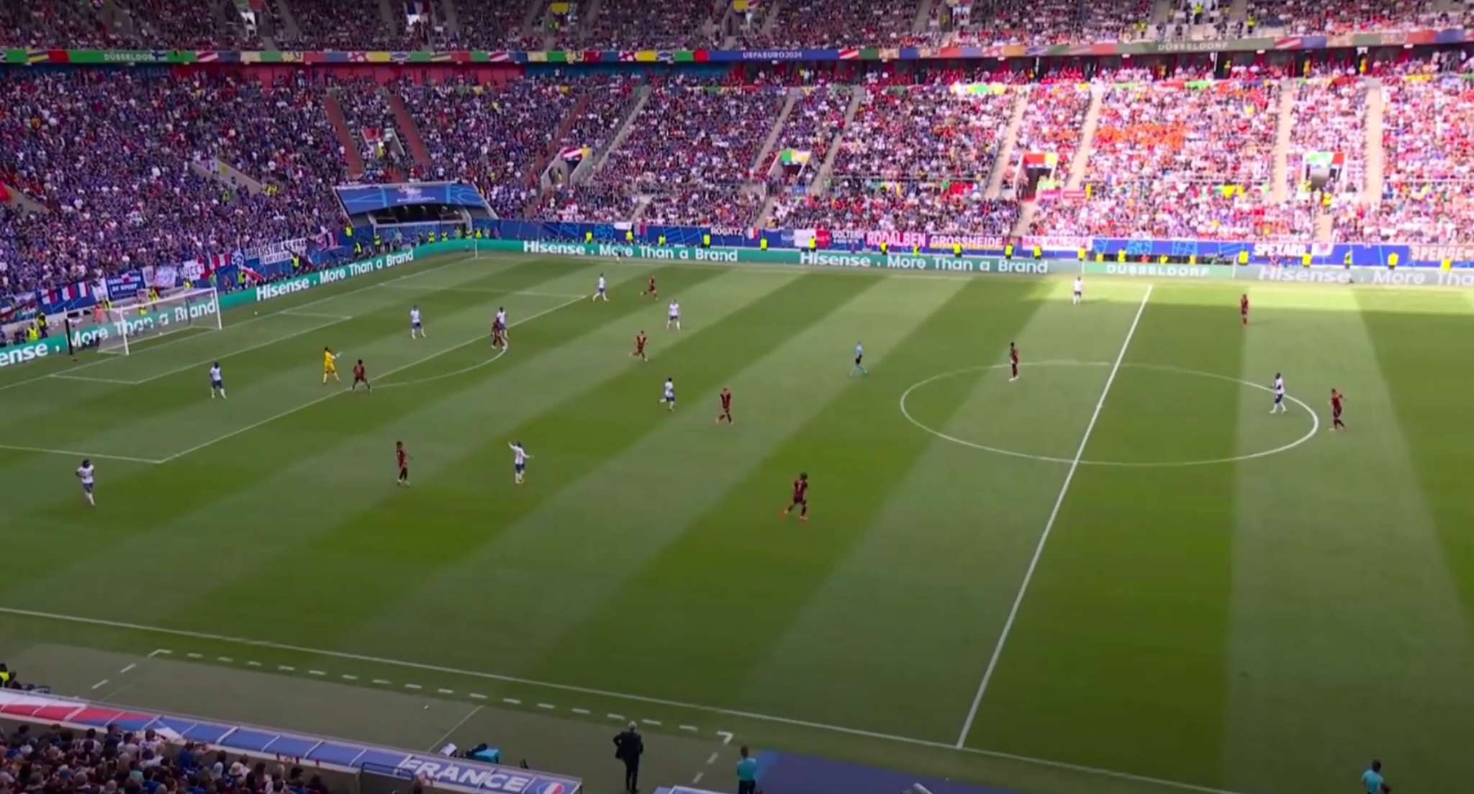
Pitch Control ≠ Possession: PCI measures the probability of a team being the first to reach the ball in a given area, focusing on zone control rather than ball control.
Control Without Possession: a team can dominate the pitch even without the ball, e.g., by pressing high and closing spaces, which still offers an advantage.
Current implementation only considers players' instantaneous positions, excluding direction and speed.

Slide 10
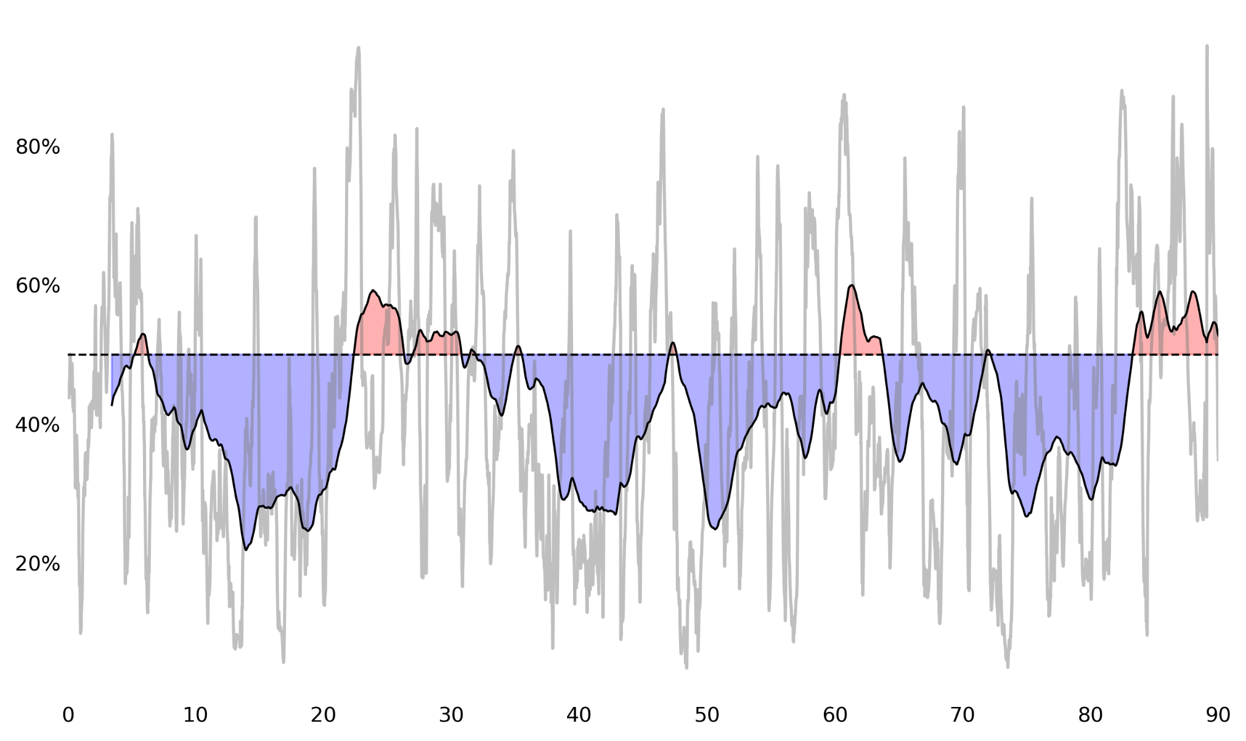
Pitch Control Index - Algorithm
Algorithm: Computes the Voronoi diagram every 10 timestamps (0.4 seconds) and tracks the percentage of field controlled by each team.
Implementation: Vonoroi package in Python was not considering pitch edges, I needed to adapt the function to the football field
Post-Processing: moving average to smooth the percentage values over time.

Slide 11
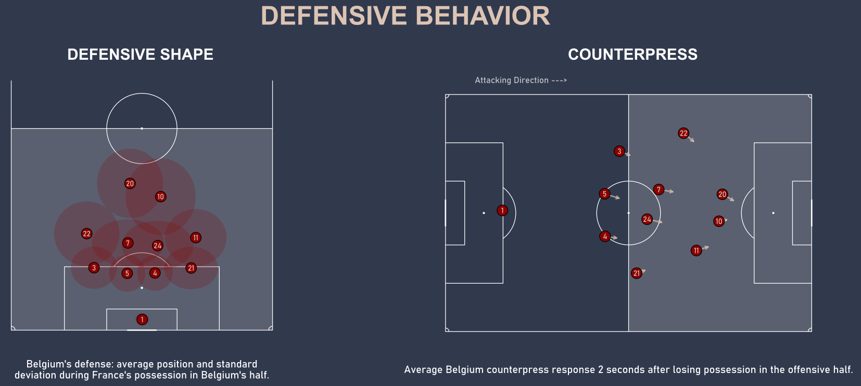
DEFENSIVE BEHAVIOR SECTION

Slide 12
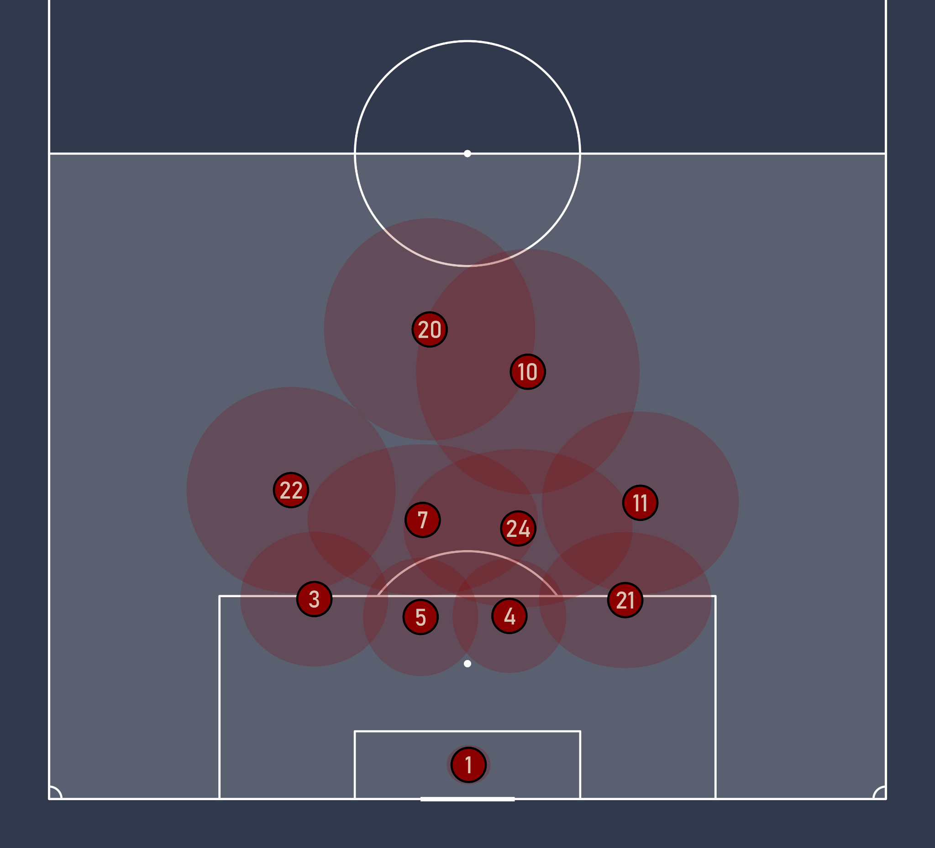
Defensive Behavior - Defensive Shape
Defensive Shape: average position when opponent has the ball in Belgium defensive third
Also shows latitudinal and longitudinal standard deviations
Potential issue: substitutions
Notes:
one problem here was handling the substitutions: just swapping players in the average position calculation doesn’t make sense, because of the different roles, for example the substitution Openda - Mangala

Slide 13
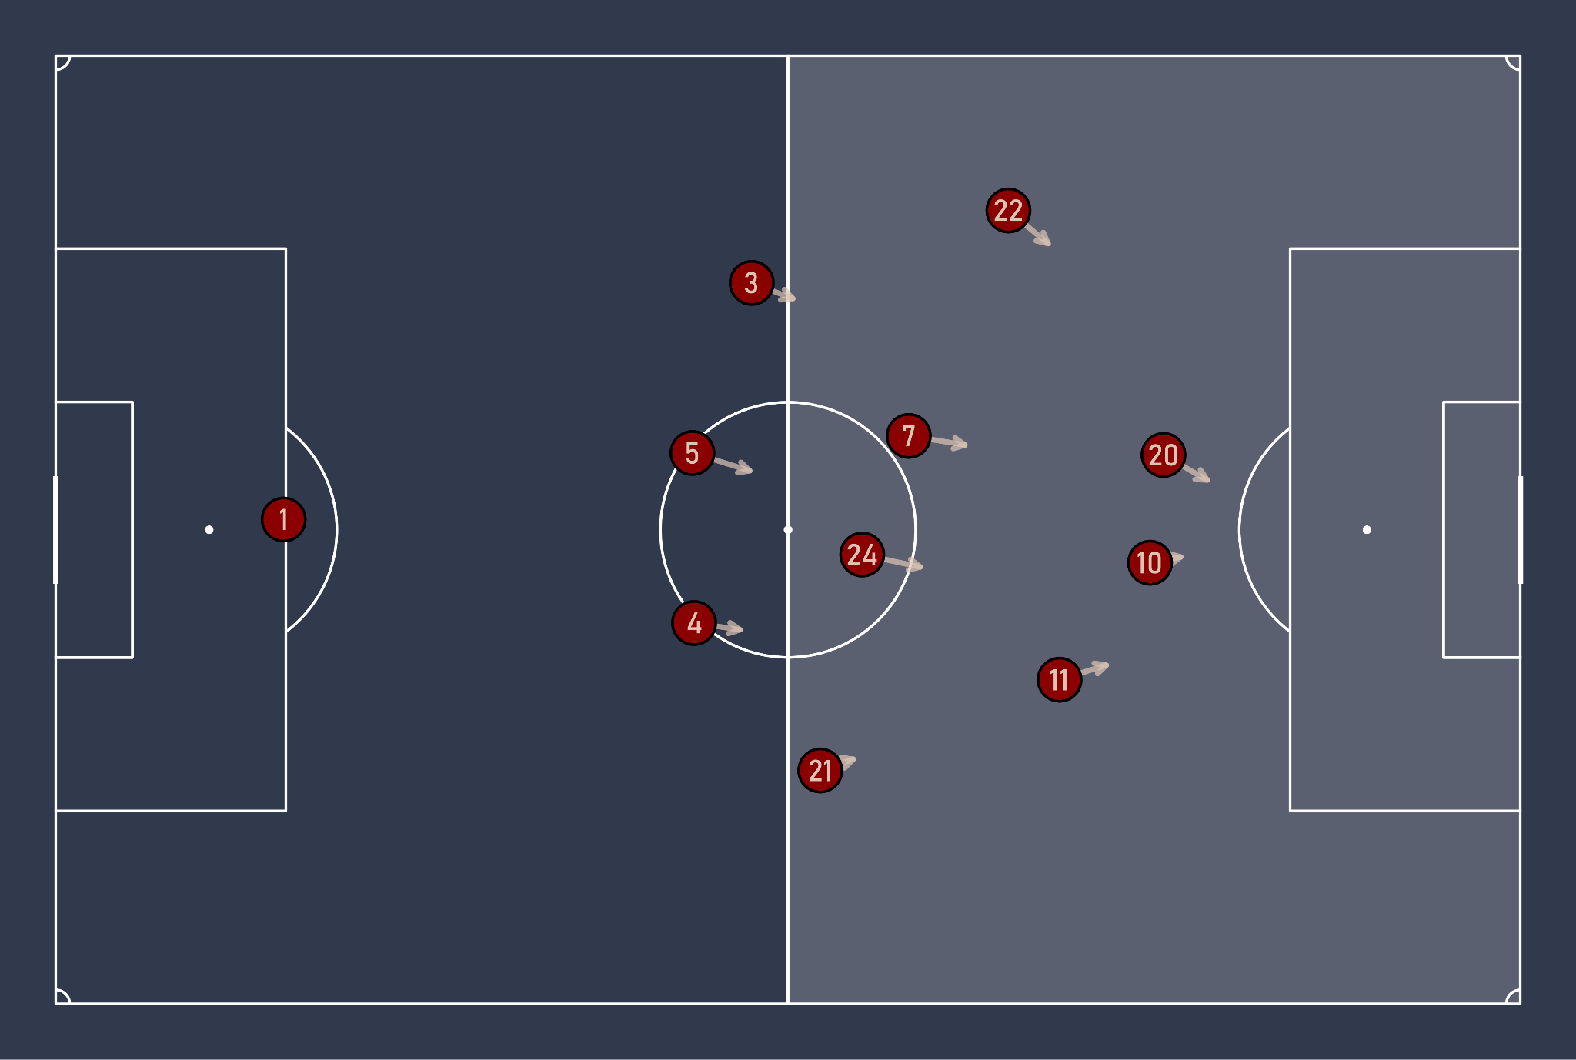
Defensive Behavior - Counterpress
Counterpress: analyzes what happens immediately after losing the ball in the opponent's half
Pseudocode:
Filter data for Belgium's possession in France's half
Identify when France gains possession (after Belgium loses the ball)
For each Belgium player, calculate average positions at possession change and after 2 seconds
Return the average positions for each player before and after losing the ball
Notes:
To identify when Belgium lost the ball: shift the possession team by one, find rows where there is a change in possession

Slide 14
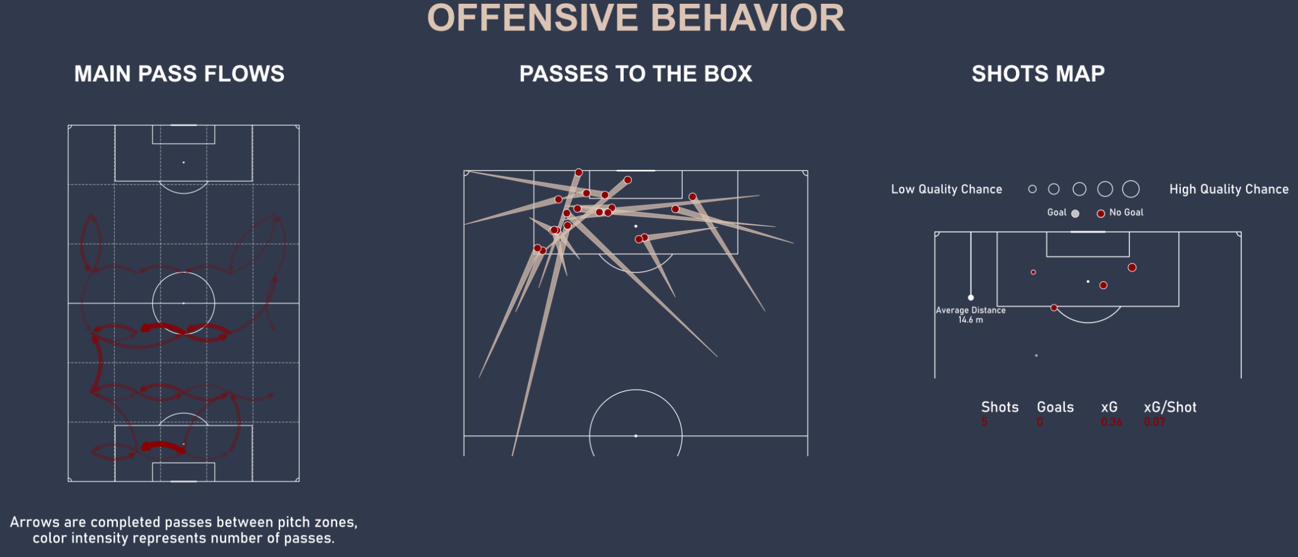
OFFENSIVE BEHAVIOR SECTION

Slide 15
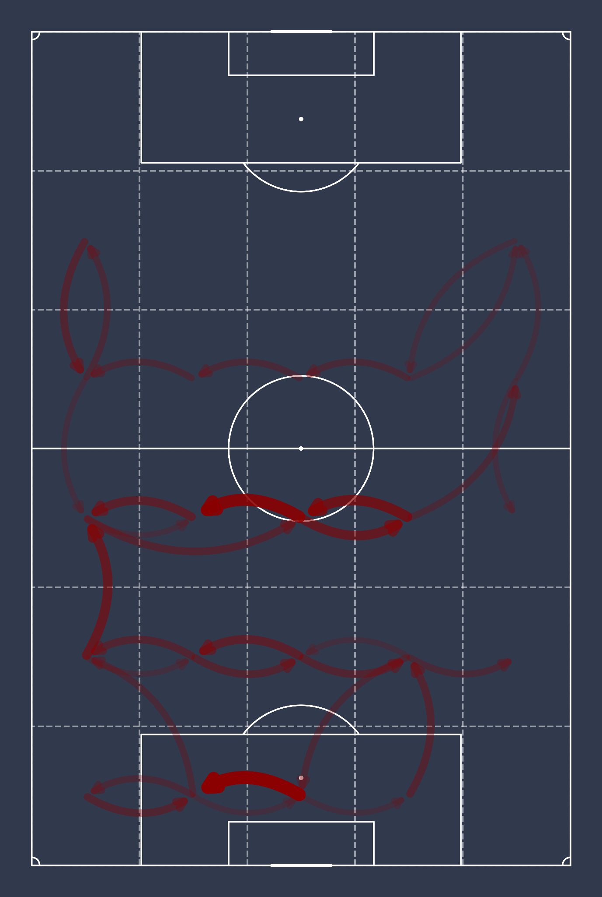
Offensive Behavior - Pass Flows
Idea: identify the most common passing patterns across pitch regions
Method: split the field in 6x5 blocks, count successful passes between different blocks
Visualization: display only passing patterns with a minimum of 3 passes, color intensity and arrow size to represent the frequency of passes between regions
Notes:
one problem here was handling the substitutions: just swapping players in the average position calculation doesn’t make sense, because of the different roles, for example the substitution Openda - Mangala

Slide 16
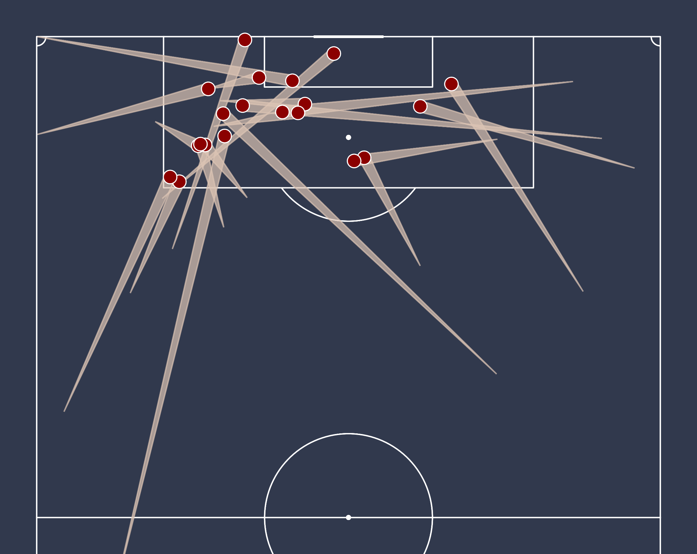
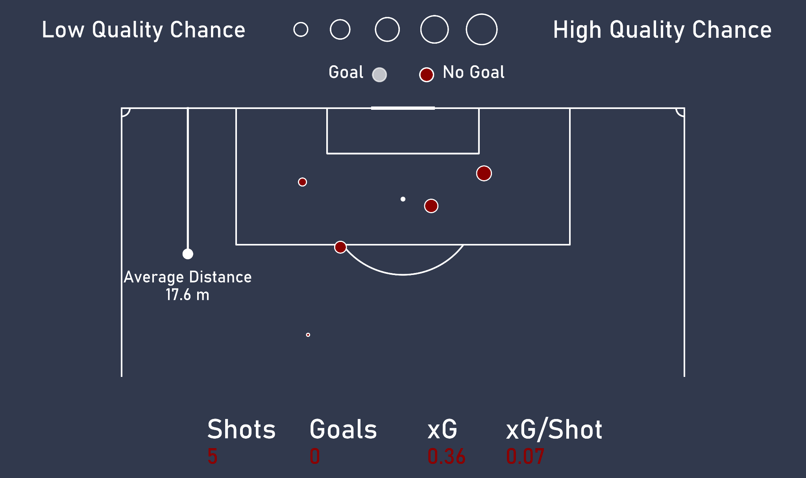
Offensive Behavior - Passes to the Box & Shot Map
Notes:
distance considers both x and y, so also the angle

Slide 17
Conclusions
Possible Improvements:
The dashboard can be automated to generate reports automatically using for example Streamlit, enhancing the ease of data analysis and reporting.
Pitch Control Index can be enhanced by incorporating player pace and direction holds great potential. This can also be further developed by adding additional features to create a more comprehensive model.
A dynamic counterpress visualization, especially when considering different time windows, can be even more effective to understand behavior in a crucial moment as dispossession
Final remark: thank you for the opportunity, it was super inspiring and rewarding to work on this assignment!

